Slide 1


Use Dijkstra’s Algorithm to find the shortest path of the maze
Xin Wan ( student# 9219)

Slide 2
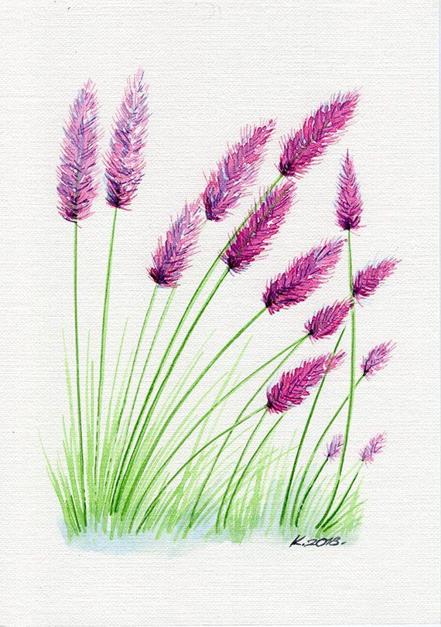
Subjects
Introduction
Maze
Maze Tree
Shortest path solution
Conclusion
References

Slide 3


Introduction
Dijkstra’s algorithm solves the single-source shortest-paths problem on a directed weighted graph, where all the edges are non-negative for each edge.

Slide 4
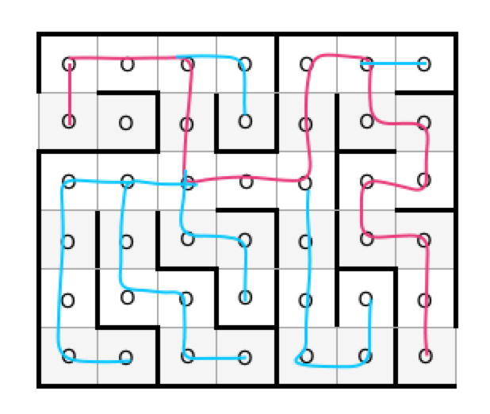
Maze
S
 |  |  |  |  |  | E

Slide 5
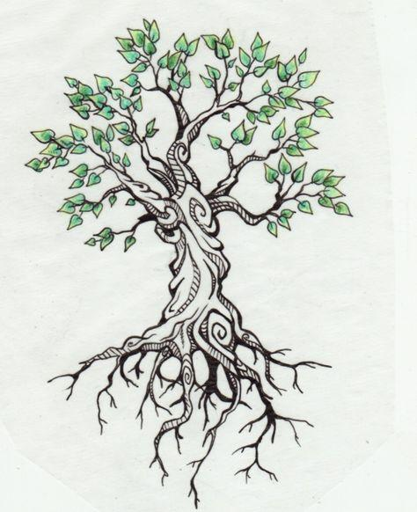

Maze Tree
A O S
|
| 3
|
B O
/ \
2 / \ 2
C O D O
/ / \
1 / / 3 \ 2
E O F O G O
/ \ 5 / \
5 / \ 5 / \ 3
/ \ J O \
/ \ K O
H O I O / \
/ \
1 / \ 8
/ \
L O M O E

Slide 6
Shortest path solution
Vertex (accumulated path) | I | 1 | 2 | 3 | 4 | 5 | 6 | 7 | 8 | 9 | 10
 | Next Step A | Next Step B | Next Step C | Next Step D | Next Step E | Next Step H | Next Step I | Next Step G | Next Step K | Next Step L | End at M
A | 0 | 0 | 0 | 0 | 0 | 0 | 0 | 0 | 0 | 0 | 0
B | i | 3 | 3 | 3 | 3 | 3 | 3 | 3 | 3 | 3 | 3
C | i | i | 5 | 5 | 5 | 5 | 5 | 5 | 5 | 5 | 5
D | i | i | 5 | 5 | 5 | 5 | 5 | 5 | 5 | 5 | 5
E | i | i | i | i | 6 | 6 | 6 | 6 | 6 | 6 | 6
F | i | i | i | i | 8 | 8 | 8 | 8 | 8 | 8 | 8
G | i | i | i | i | 7 | 7 | 7 | 7 | 7 | 7 | 7
H | i | i | i | i | i | 11 | 11 | 11 | 11 | 11 | 11
I | i | i | i | i | i | 11 | 11 | 11 | 11 | 11 | 11
J | i | i | i | i | i | i | i | i | 12 | 12 | 12
K | i | i | i | i | i | i | i | i | 10 | 10 | 10
L | i | i | i | i | i | i | i | i | i | 11 | 11
M | i | i | i | i | i | i | i | i | i | 18 | 18
I: Initial i: infinite

Slide 7
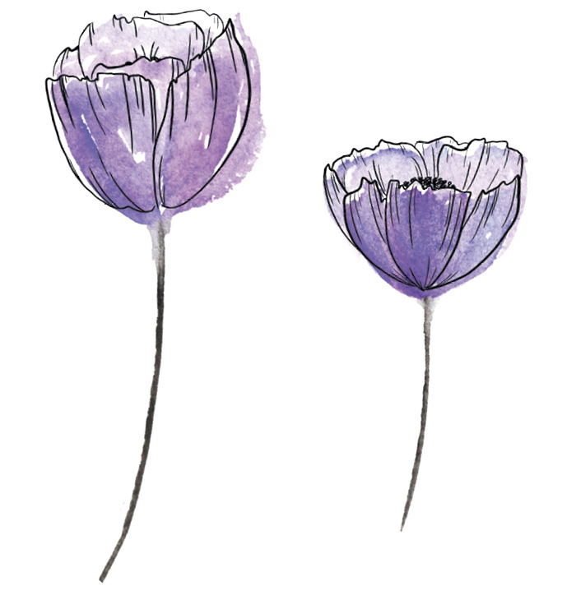

Conclusion
The shortest path which is the minimum distance of the maze is 3+2+2+3+8 = 18 .
And the path is: A -> B -> D -> G -> K -> M

Slide 8


References
Maze
Shortest Path

